Slide 1
Ecommerce Product Categorization Overview
Effective product categorization is vital for enhancing eCommerce operations. It ensures customers experience seamless navigation to find desired products easily. This presentation focuses on addressing challenges in product categorization using data science techniques and innovative solutions, particularly for ambiguous product descriptions and diverse product offerings.
AH
by Asif Hussain

Slide 2


Hackathon Objectives
1
Data Exploration
Understand dataset features and address missing data.
2
Descriptive Analysis
Identify patterns and visualize insights in product descriptions.
3
Feature Engineering
Transform raw data into meaningful numerical features.
4
Model Development
Create robust models using text data for categorization.

Slide 3

Data Preparation Steps
Dataset Cleaning
1
Remove duplicates and handle missing values to enhance quality.
2
Data Normalization
Standardize descriptions for better consistency across entries.
Feature Encoding
3
Encode product categories for improved machine learning integration.

Slide 4
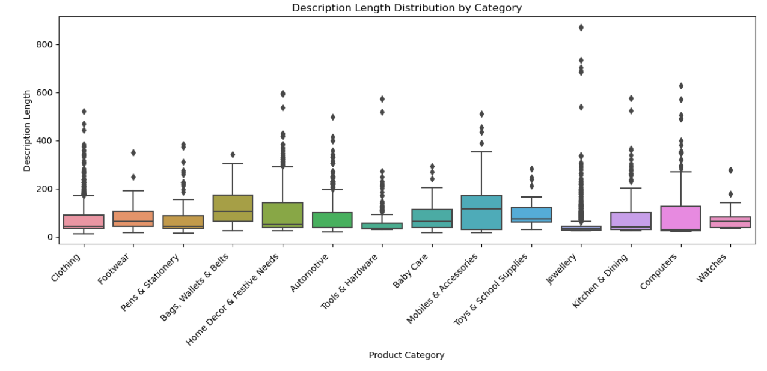
Description Length Distribution by Category
Descriptions for products in the “Mobiles & Accessories” category tend to be the longest, followed by “Kitchens & Dining” and “Computers.”
Descriptions for products in the “Clothing” ,”watches” and “Footwear” categories tend to be on the shorter side.

Slide 5
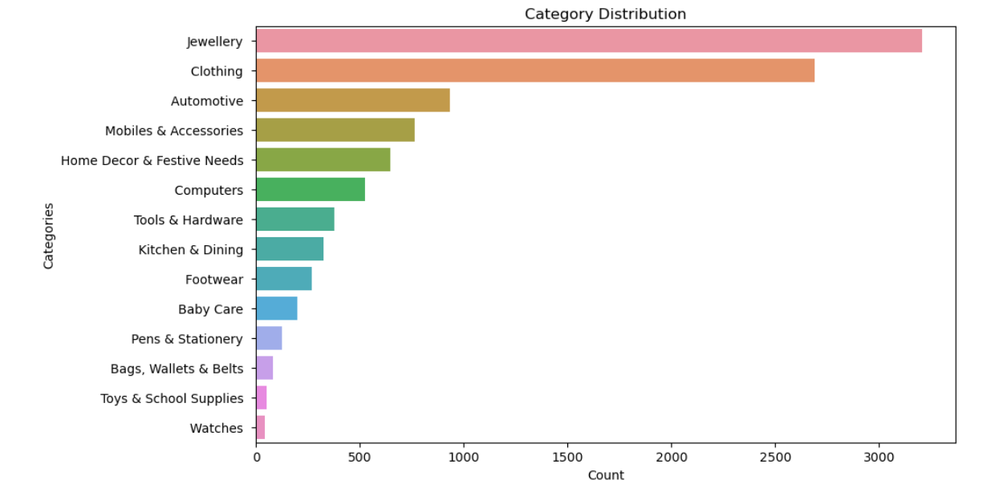
Category Distribution
Dataset contains more categories of “Clothing” followed by "Jewellery" and "Footwear", this implies that customers are more interested in buying this products probably female customers

Slide 6

Text Normalization Techniques
Lowercase Conversion
Whitespace Removal
Converts all text to lowercase for uniformity.
Eliminates unnecessary whitespace for cleaner data.
Punctuation Removal
Stop Words Elimination
Strips punctuation to ensure focus on relevant words.
Removes common words that may not contribute to categorization.

Slide 7
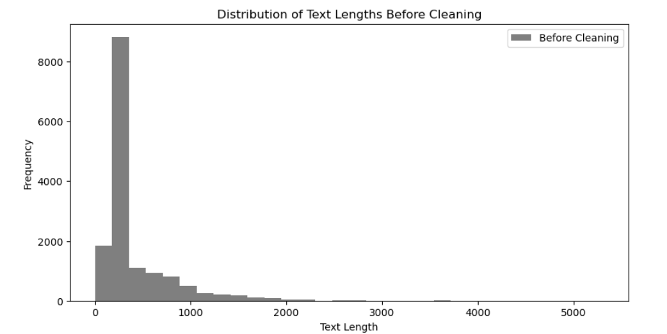
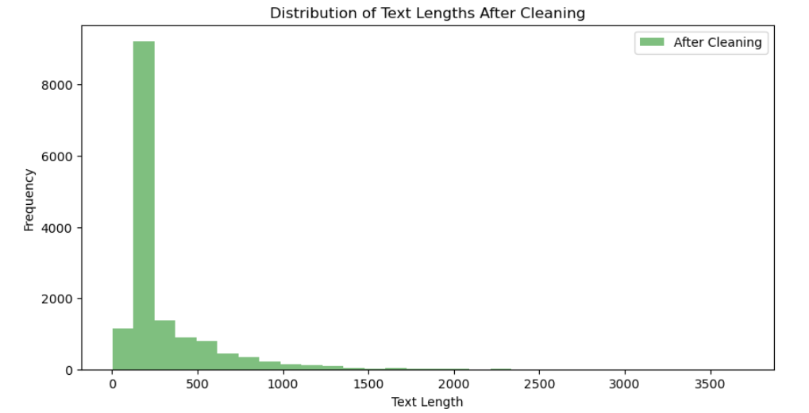
Distribution of Text Length
The cleaning process applied to the text data has resulted in a significant reduction in text length, with an average reduction of approximately 27.10%. This reduction indicates that the cleaning techniques effectively removed extraneous content, noise, punctuation, stopwords, and other irrelevant information from the text data.

Slide 8
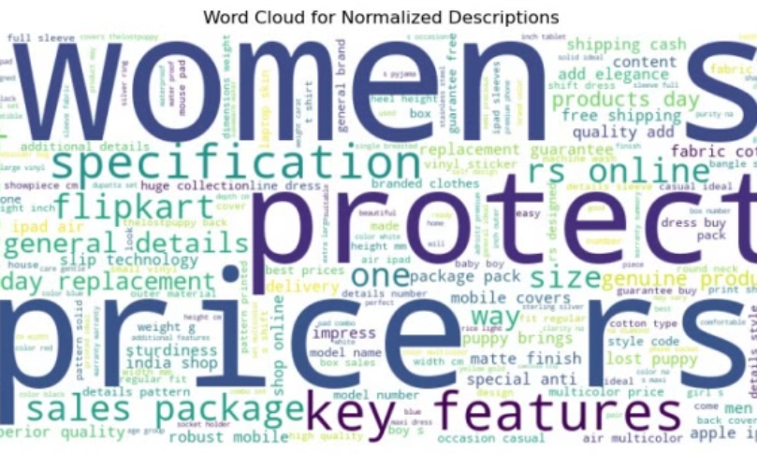
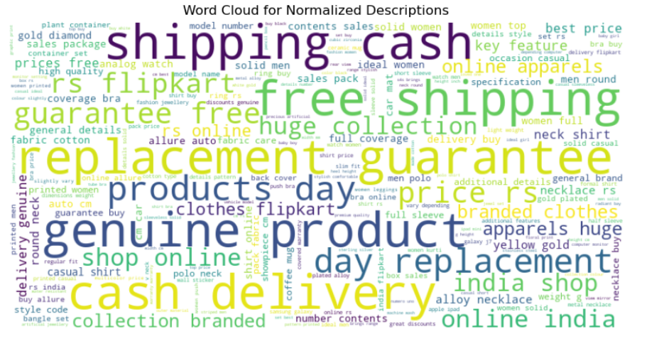
Word Cloud Distribution

Slide 9
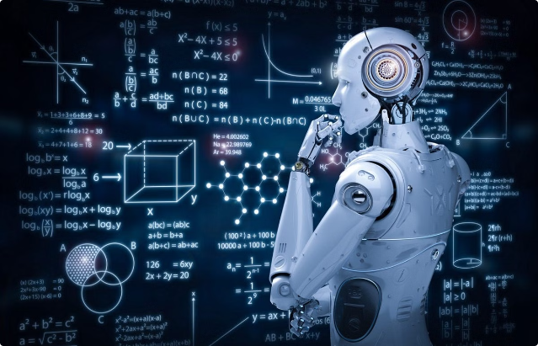
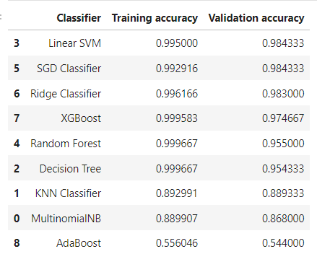
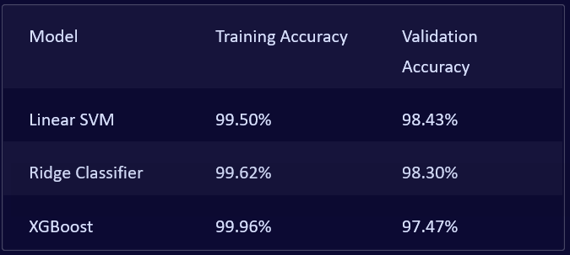
Applying Models on TF-IDF
The Ridge Classifier, SGD Classifier, and Linear SVM stand out with high training and validation accuracies. This indicates that these models are robust and generalize well to new data, making them the best choices for this task.

Slide 10
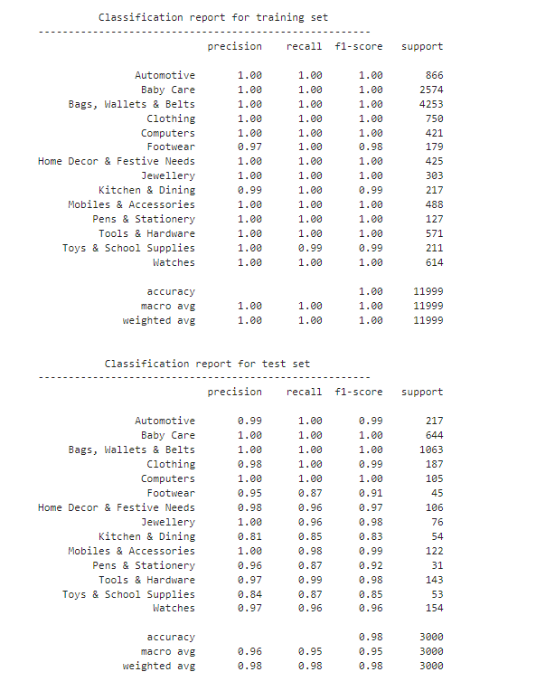
Hyper Parameter Tuning

Slide 11

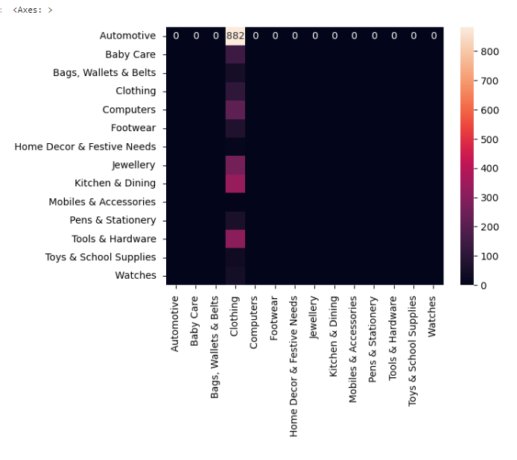
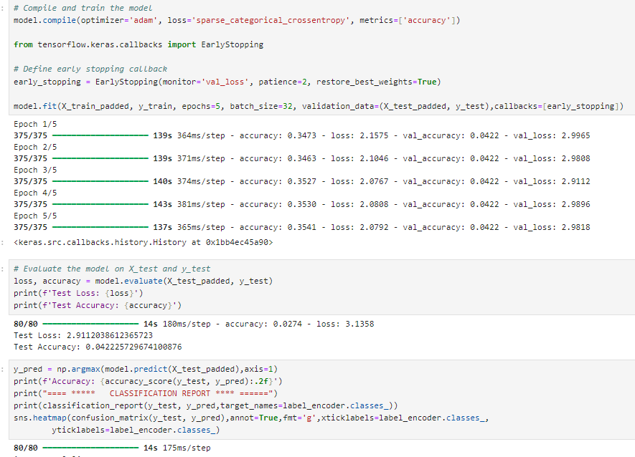
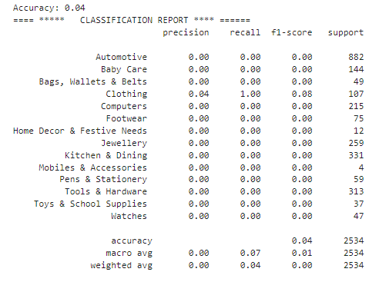
Deep Learning Accuracy

Slide 12

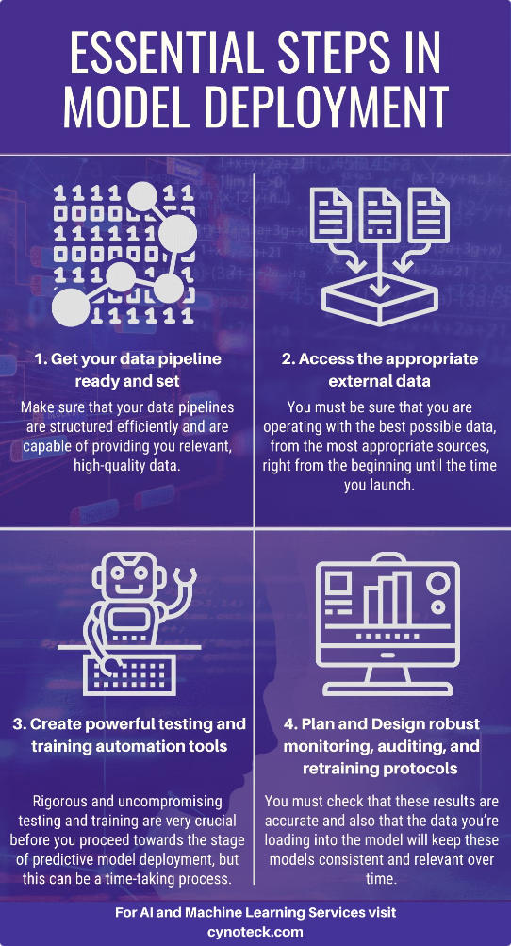
Final Model Deployment
1
Model Storage
Utilizes pickle and joblib for model persistence.
2
TF-IDF Vectorizer
Saves the vectorizer for transforming new text data.
3
Future Updates
Models can be retrained for continuous improvement.
4
Performance Monitoring
Regularly evaluate the model against new data.

Slide 13

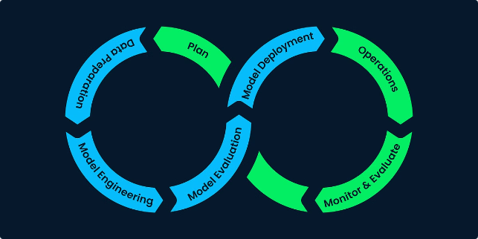
Conclusion and Recommendations
Optimal Machine Learning Models
Linear SVM and Ridge Classifier are highly effective.
Deep Learning Limitations
Deep learning yielded lower validation accuracy compared to classical methods.
Future Directions
Explore ensemble methods for improved performance and efficiency.

Slide 14
Thank You

